Slide 1

ECE 478-578 Intelligent Robotics I
PhD. Husnu Melih Erdogan – Electrical & Computer Engineering
herdogan@pdx.edu Teaching Assistant – Lab Assistant

Slide 2

ROS Review

Slide 3
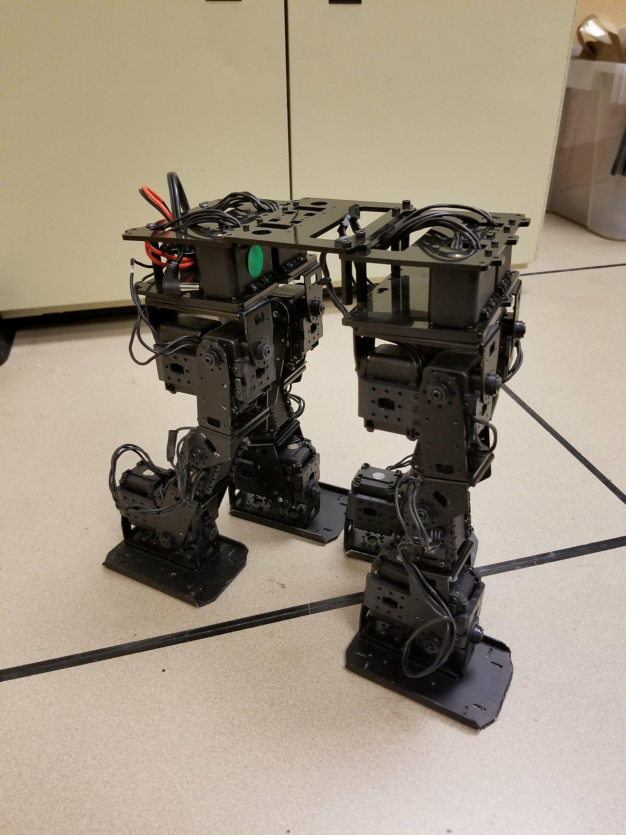
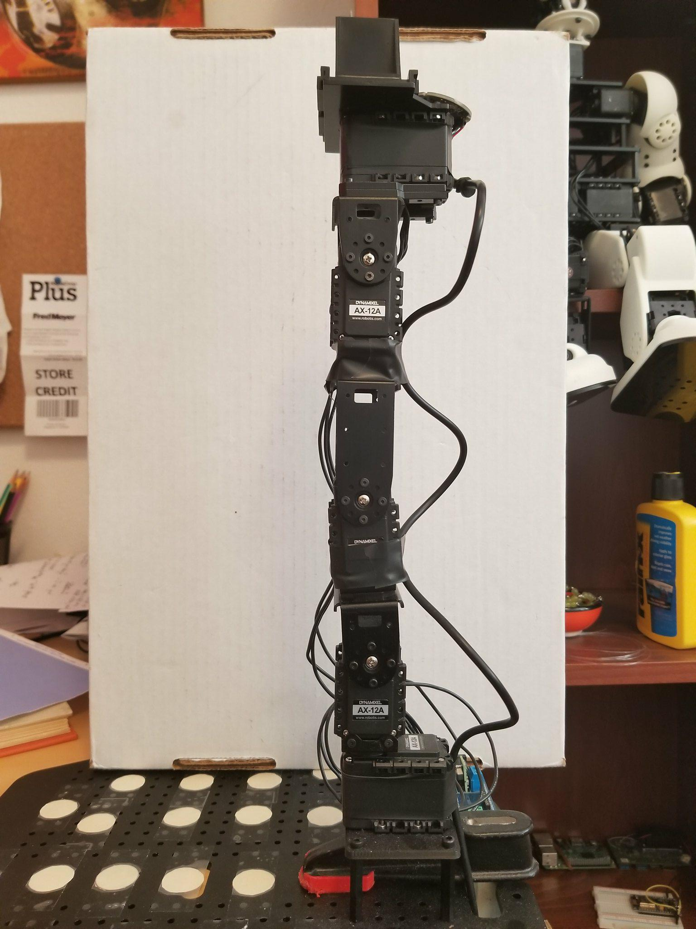
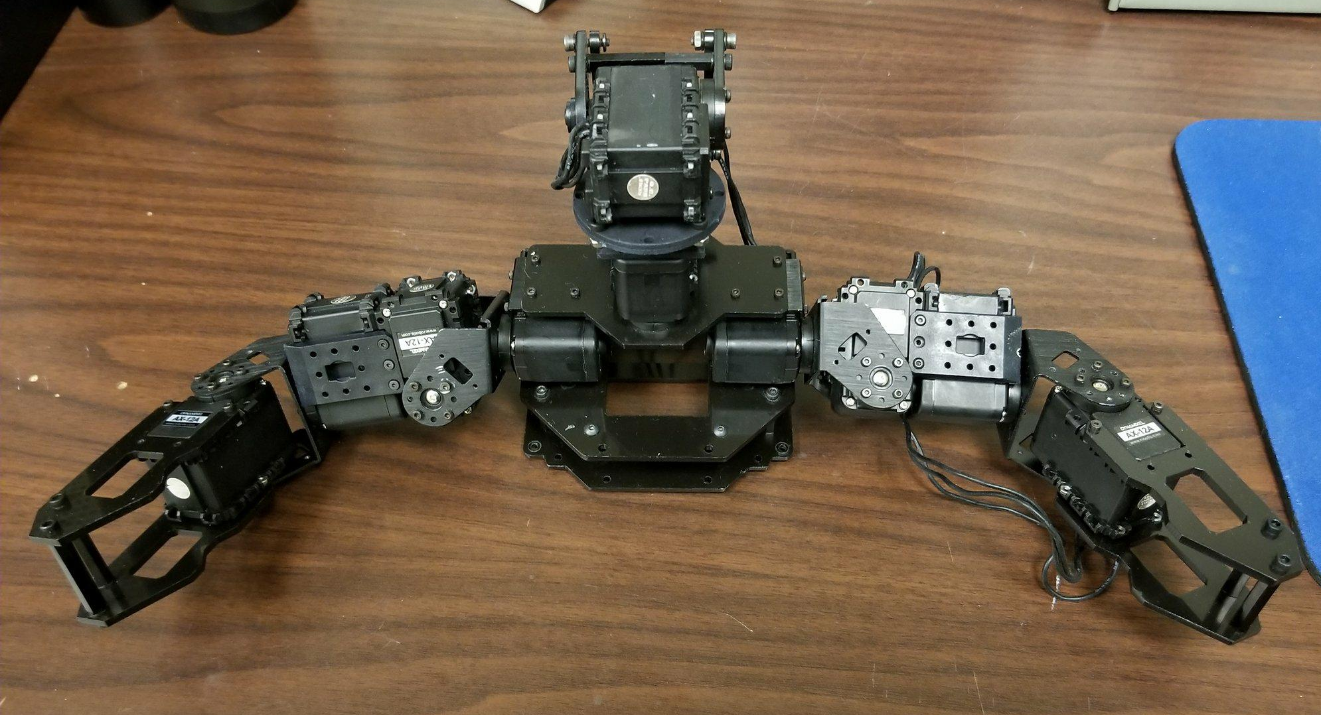
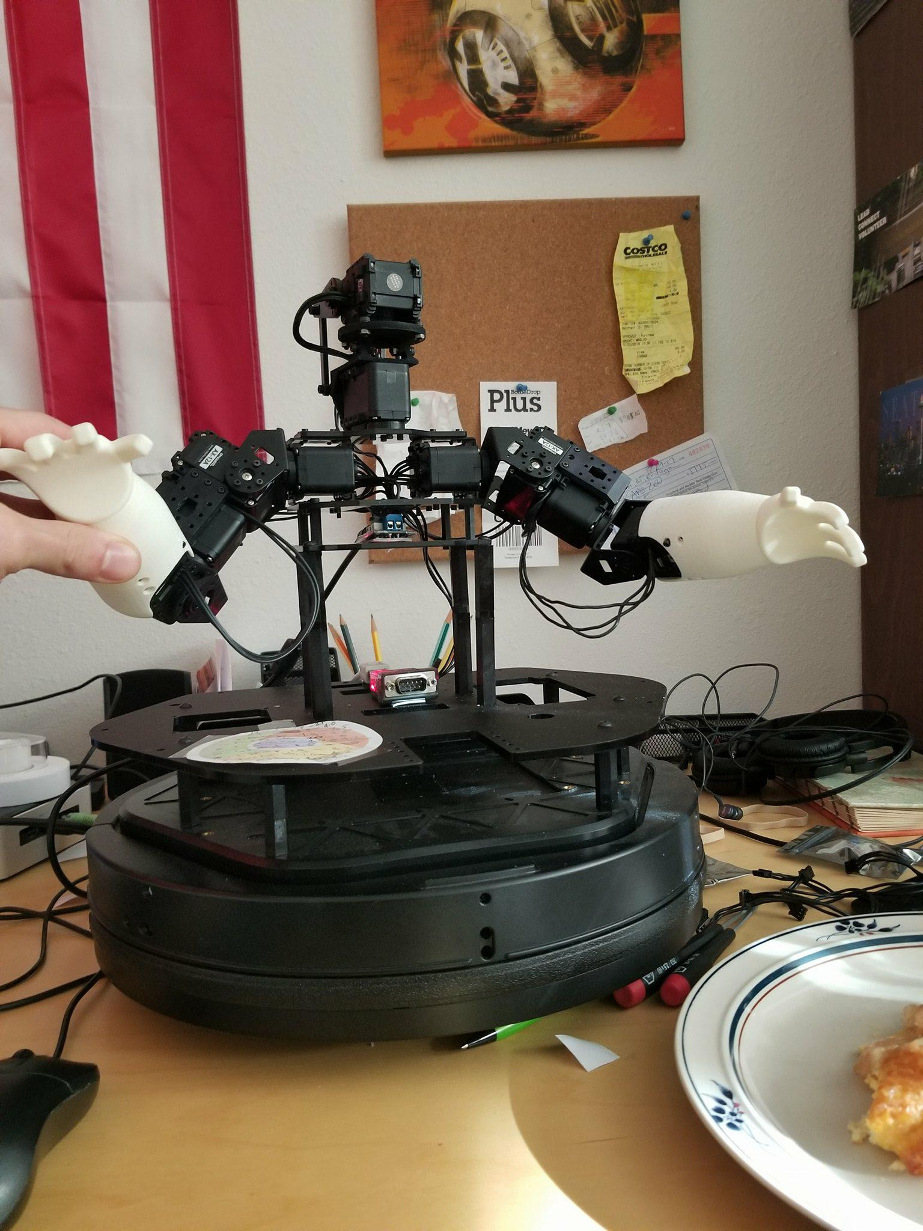
ROBOTS

Slide 4
ROS (Robot Operating system)

Slide 5

Course Structure
ROS Services and Messages
ROS Parameters
Writing a Service and Client
ROS .bag file
URDF
TF
RVIZ
Getting started with Turtlebot
MoveIt
Creating Vikingbot URDF
Robot_State_Publisher
Joint_State_Publisher
Gazebo
What is ROS?
Introduction to ROS
ROS architecture, philosophy, history
How to install ROS?
Examples
XML Format
ROS commands
Getting familiar with the ROS filesystem
How to create a ROS package?
How to build a ROS package?
How to install released ROS packages?
How to build packages from source?
ROS Nodes Detail
ROS Topics Detail
Writing a Publisher and Subscriber

Slide 6
What is ROS?
ROS stands for Robot Operating System.
However it is not a real operating system such a Linux, Windows, OSX
It is framework.
It is more like a middleware that sits between your operating system and your program in C++, Python, and Matlab etc.

Slide 7
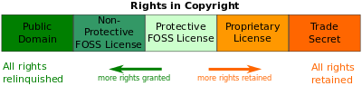
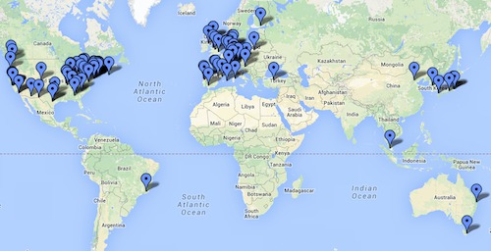
Why ROS is useful?
A distributed, modular design
A very large community
Permissive Licensing
"lets people do anything they want with your code as long as they provide attribution back to you and don’t hold you liable."
Collaborative Environment
It is free.
Supports different programming languages
Matlap, C++, Python, Lisp
A very important technical skill to have in your resume.

Slide 8
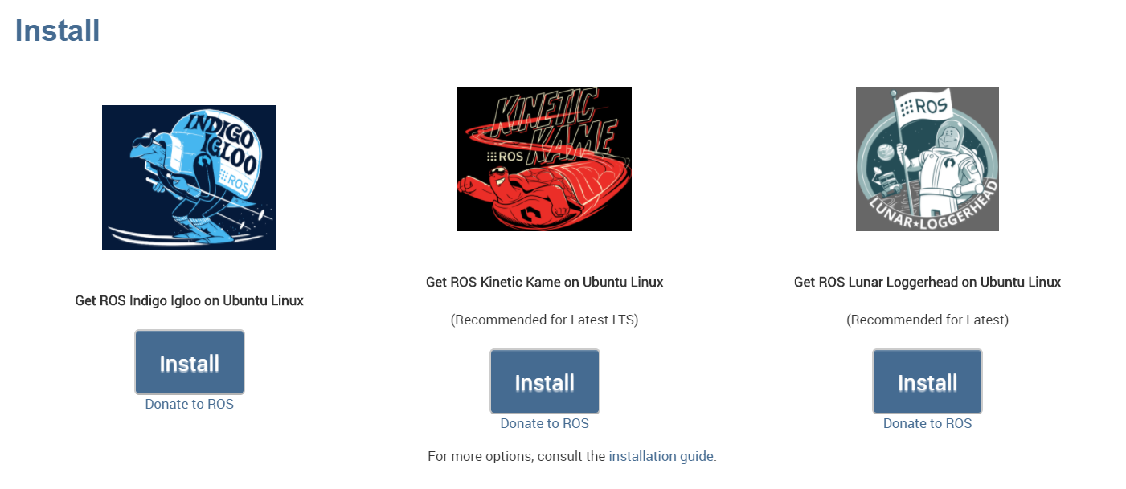
Current Distributions

Slide 9
ROS Philosophy
Peer to Peer
Individual programs communicate over defined API (ROS messages, services)
Distributed
Programs can be run on multiple computers and communicate over the network.
Supports Multiple Languages
ROS modules can be written in any language for which a client library exist (C++, Python, MATLAB, Java, etc.)
Light-weight
Stand-alone libraries are wrapped around with in a thin ROS layer.
It doesn’t mean ROS doesn’t use your CPU or don’t need a powerful PC.
Some packages could use all almost your system resources.
Free and Open-Source
It is totally free and supported by a considerably large community.
It is backed by many universities and industrial companies.
It becomes a standard in the robotics field.

Slide 10
ROS Core Components
There are three core components:
Communications Infrastructure
Robot-Specific Features
Tools

Slide 11
Communications Infrastructure
At the lowest level, ROS offers a message passing interface that provides inter-process communication and is commonly referred to as a middleware.
The ROS middleware provides these facilities:
publish/subscribe anonymous message passing
recording and playback of messages
request/response remote procedure calls
distributed parameter system

Slide 12
Message Passing
A communication system is often one of the first needs to arise when implementing a new robot application.
ROS's built-in and well-tested messaging system saves you time by managing the details of communication between distributed nodes via the anonymous publish/subscribe mechanism.
Another benefit of using a message passing system is that it forces you to implement clear interfaces between the nodes in your system, thereby improving encapsulation and promoting code reuse.
The structure of these message interfaces is defined in the message IDL (Interface Description Language).

Slide 13
Recording and Playback of Messages
Because the publish/subscribe system is anonymous and asynchronous, the data can be easily captured and replayed without any changes to code.
Say you have Task A that reads data from a sensor, and you are developing Task B that processes the data produced by Task A. ROS makes it easy to capture the data published by Task A to a file, and then republish that data from the file at a later time.
This is a powerful design pattern that can significantly reduce your development effort and promote flexibility and modularity in your system.
We can run the robot itself only a few times, recording the topics we care about, and then replay the messages on those topics many times, experimenting with the software that processes those data.

Slide 14
Remote Procedure Calls
The asynchronous nature of publish/subscribe messaging works for many communication needs in robotics, but sometimes you want synchronous request/response interactions between processes.
The ROS middleware provides this capability using services. Like topics, the data being sent between processes in a service call are defined with the same simple message IDL.

Slide 15
Distributed Parameter System
The ROS middleware also provides a way for tasks to share configuration information through a global key-value store.
This system allows you to easily modify your task settings, and even allows tasks to change the configuration of other tasks.

Slide 16
Robot-Specific Features
In addition to the core middleware components, ROS provides common robot-specific libraries and tools that will get your robot up and running quickly. Here are just a few of the robot-specific capabilities that ROS provides:
Standard Message Definitions for Robots
Robot Geometry Library
Robot Description Language
Preemptable Remote Procedure Calls
Diagnostics
Pose Estimation
Localization
Mapping
Navigation

Slide 17
Tools
One of the strongest features of ROS is the powerful development toolset.
These tools support introspecting, debugging, plotting, and visualizing the state of the system being developed.
The underlying publish/subscribe mechanism allows you to spontaneously do self-analysis of the data flowing through the system, making it easy to comprehend and debug issues as they occur.
The ROS tools take advantage of this introspection capability through an extensive collection of graphical and command line utilities that simplify development and debugging.

Slide 18
Command-Line Tools
ROS can be used 100% without a GUI.
All core functionality and introspection tools are accessible via one of more than 45 ROS command line tools.
There are commands for launching groups of nodes;
introspecting topics,
services,
and actions;
recording and playing back data;
and a host of other situations.

Slide 19
rviz
Perhaps the most well-known tool in ROS, rviz provides general purpose, three-dimensional visualization of many sensor data types and any URDF-described robot.
rviz can visualize many of the common message types provided in ROS, such as
laser scans,
three-dimensional point clouds,
and camera images.
Visualizing all of your data in the same application not only looks impressive, but also allows you to quickly see what your robot sees, and identify problems such as sensor misalignments or robot model inaccuracies.

Slide 20
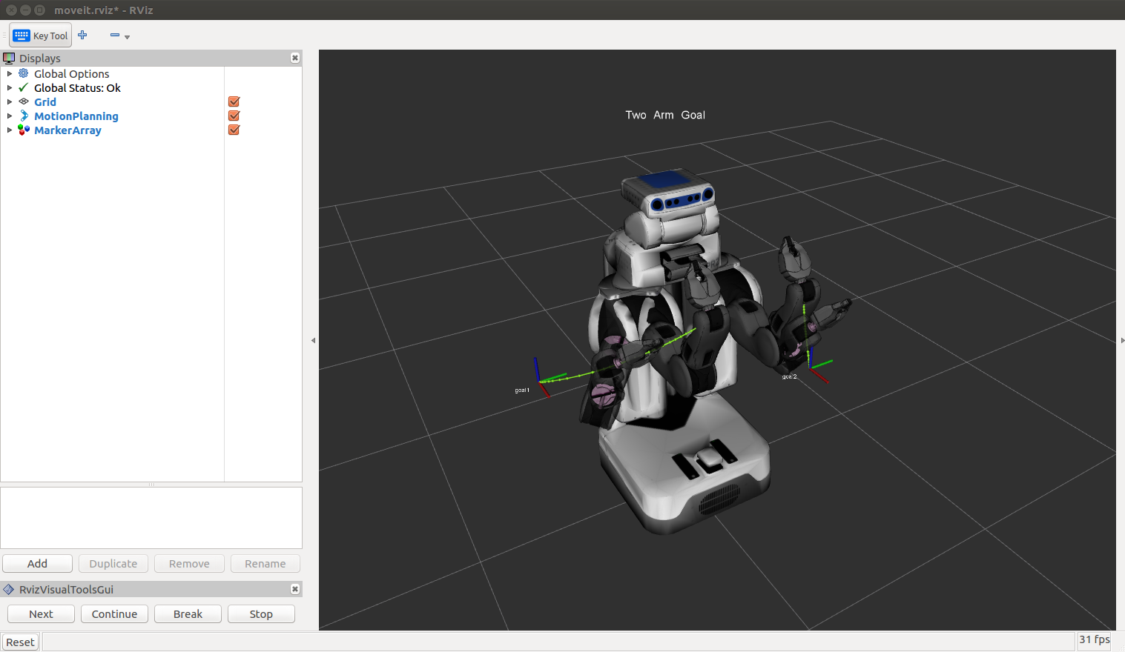
rviz

Slide 21
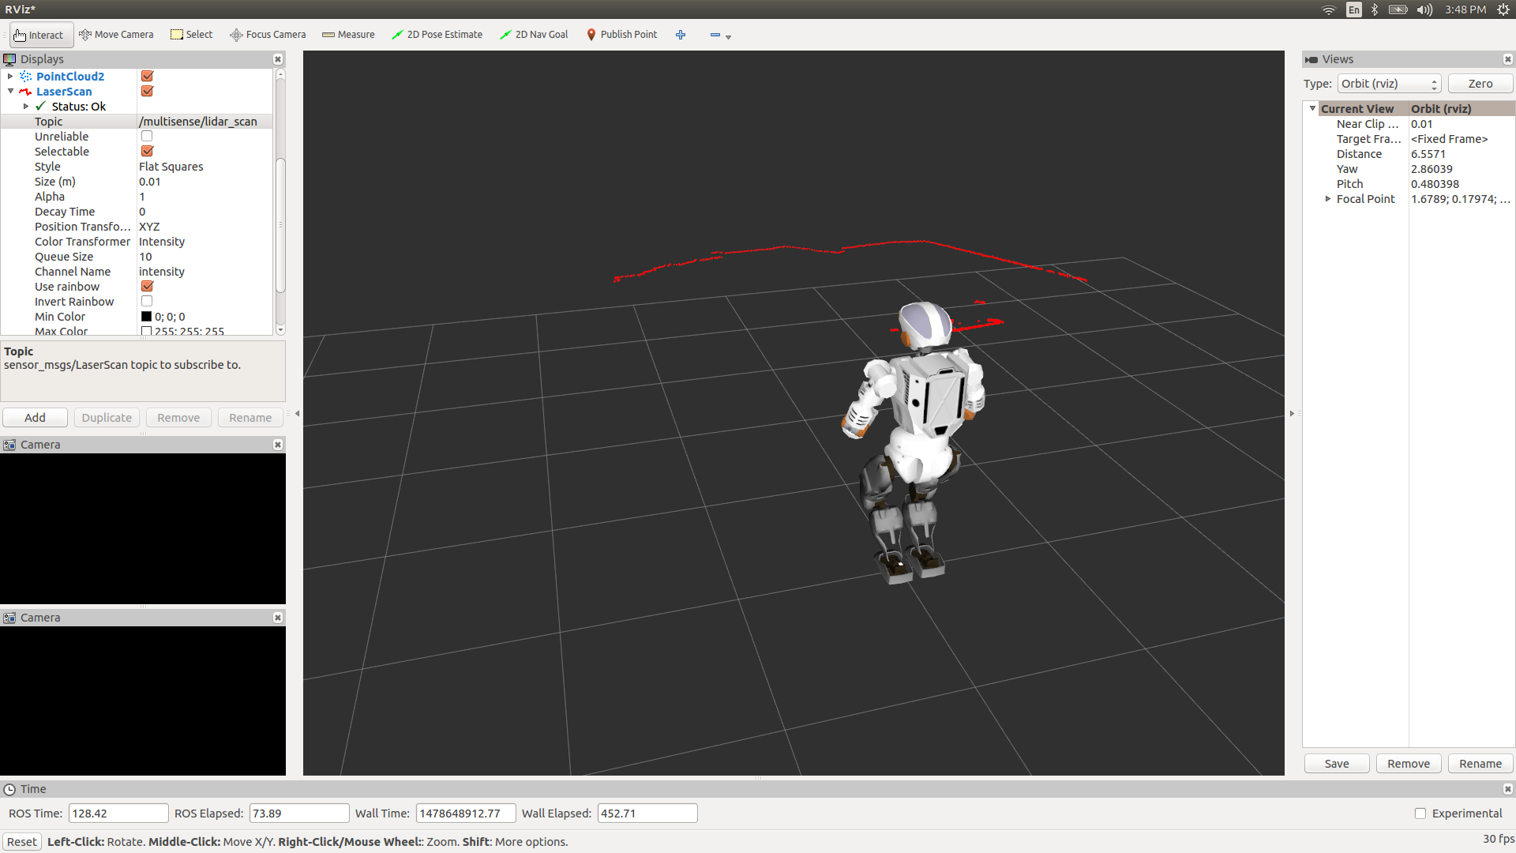
rviz

Slide 22
ROS Workspace Environment
Standard name for it catkin_ws
You can use whatever name you want.
Check your work space.
First you need to source your setup.*sh.
The setup.bash files setup your environment variables and paths.
source /opt/ros/<distro>/setup.bash
Ex: source /opt/ros/kinetic/setup.bash

Slide 23
Create a Catkin Workspace
What is catkin?
A catkin workspace is a folder where you modify, build, and install catkin packages. (wiki.ros.org)
Catkin packages can be built as a standalone project, in the same way that normal cmake projects can be built, but catkin also provides the concept of workspaces, where you can build multiple, interdependent packages together all at once.

Slide 24
Create a Catkin Workspace
- mkdir -p ~/catkin_ws/src
(create a new directory called src in another directory called catkin ws)
- cd ~/catkin_ws/src
( go into the src directory)
- catkin_init_workspace
(initialize the workspace)
cd ~/catkin_ws/
(go into your brand new workspace)
catkin_make
(build your code in a catkin workspace)
source devel/setup.bash
(Before continuing make sure you source your new setup.*sh file)
echo $ROS_PACKAGE_PATH
Test your path: /home/youruser/catkin_ws/src:/opt/ros/kinetic/share

Slide 25
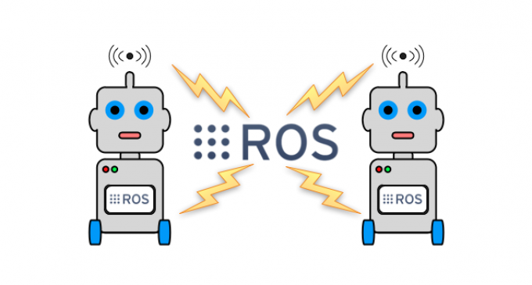
ROS Master
In charge of managing the communication between nodes
Every node registers with the master when you run them
It tracks publishers and subscribers to topics as well as services.
The main role of the Master is to enable individual ROS nodes to locate one another.
Once these nodes have located each other they communicate with each other peer-to-peer.
The Master also provides the Parameter Server.

Slide 26
ROS Master
In order to start a master type:
roscore

Slide 27
Ros Nodes
Single-purpose, executable program written in Python, C++, Matlab etc
Individually complied, executed and managed.
You can run, stop, and kill nodes whenever you want.
They run in parallel.
In order to run a node type:
rosrun package_name node_name
See active nodes running on ROS
rosnode list
In order to get more information about nodes type:
rosnode info node_name

Slide 28
ROS Master and Nodes
ROS Master
Registration
Registration
Registration
Node 1
Node 2
Node 3

Slide 29
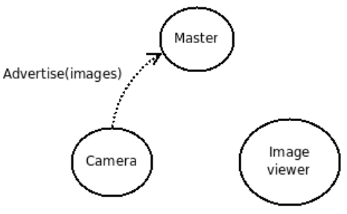
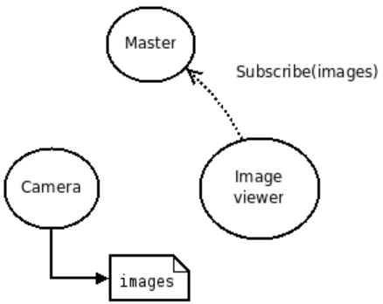
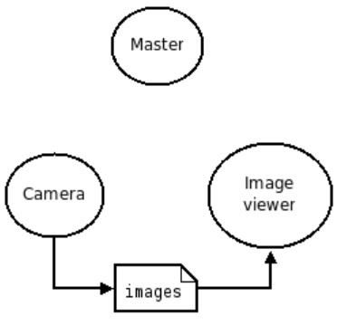
ROS Master Example
Step 1
Step 2
Step 3

Slide 30
ROS Topics
ROS Nodes communicate over topics.
Each node can publish or subscribe topics
When one of the nodes register with the master, node also tells master that I am the publisher of these topics. Therefore, other nodes can know who publishes that topic and subtribe that topic.
List all active topics :
rostopic list
Subscribe and print the contents of a topic
rostopic echo /topic-name
Show information about the topic
rostopic info /topic-name
Show all the other possible rostopic commands
rostopic -h

Slide 31
Other ROS Topic Commands
rostopic bw display bandwidth used by topic
rostopic echo print messages to screen
rostopic hz display publishing rate of topic
rostopic list print information about active topics
rostopic pub publish data to topic
rostopic type print topic type

Slide 32
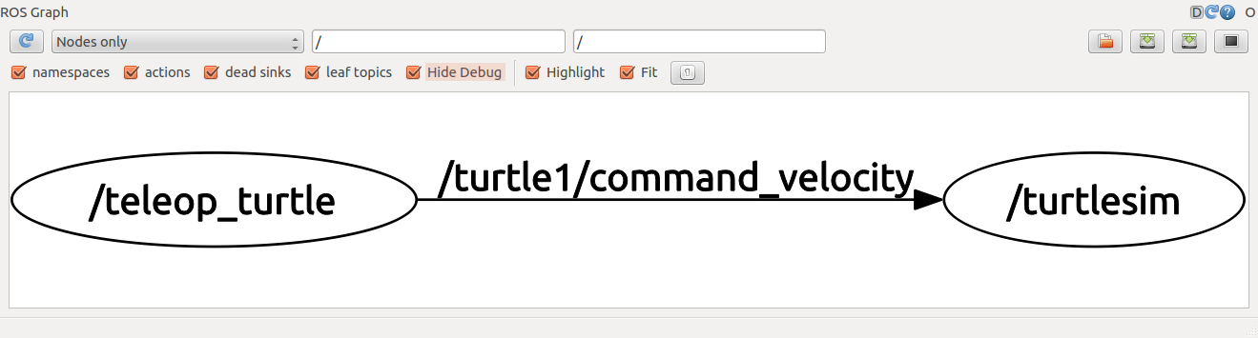
Using rqt-graph
rqt_graph tool is used to create a dynamic graph of what's going on in the system that includes all nodes and topics
To run rqt-graph
rosrun rqt_graph rqt_graph

Slide 33
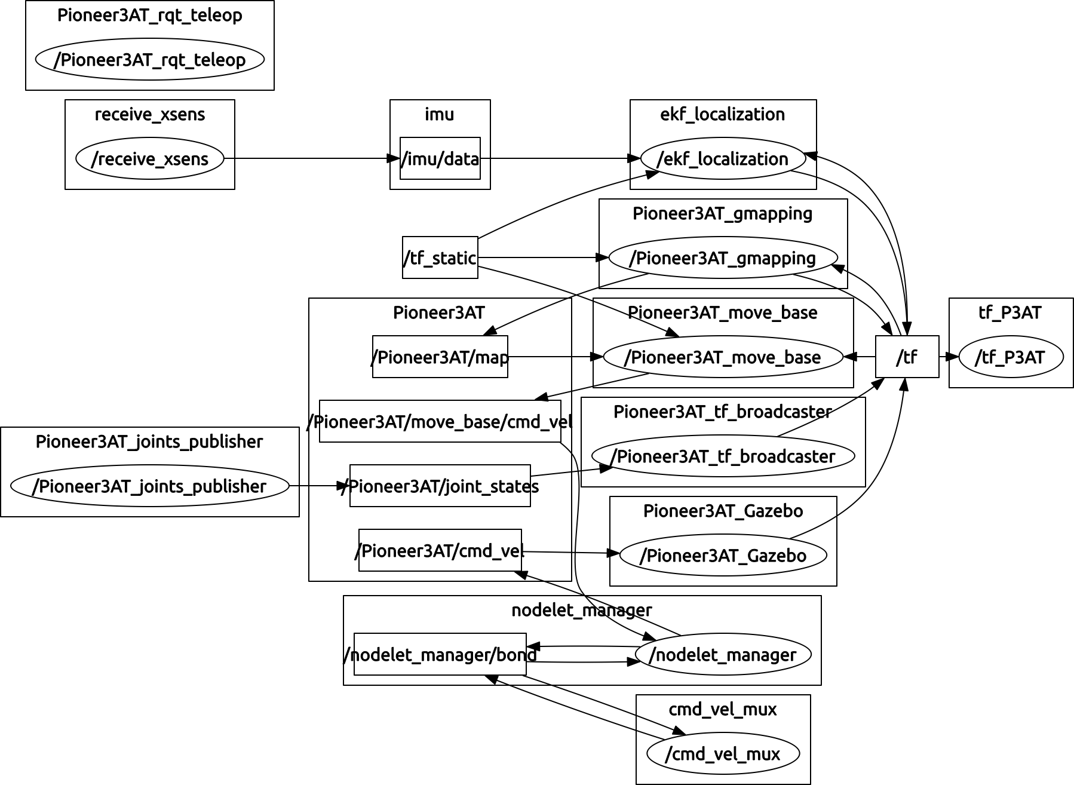
Using rqt-graph

Slide 34
ROS Master, Nodes, Topics
ROS Master
Registration
Registration
Registration
Node 1
Publisher
Node 2
Subscriber
Node 3
Subscriber and Publisher
Subscribe
Publish
Publish
Subscribe
Topic
Topic

Slide 35
ROS Messages
ROS message describes the data values that ROS nodes publish.
Messages help ROS tools to automatically generate code for the message type in several target languages.
Message descriptions are in .msg files in the msg/ directory.
Messages can be nested in each other.
Each ROS distribution can have a different description for a message
You can go to http://wiki.ros.org/msg and check the message type
Publish a message to a subscriber ROS node on command line.
rostopic pub /mytopic std_msg/String “data: ‘Portland State University’”

Slide 36
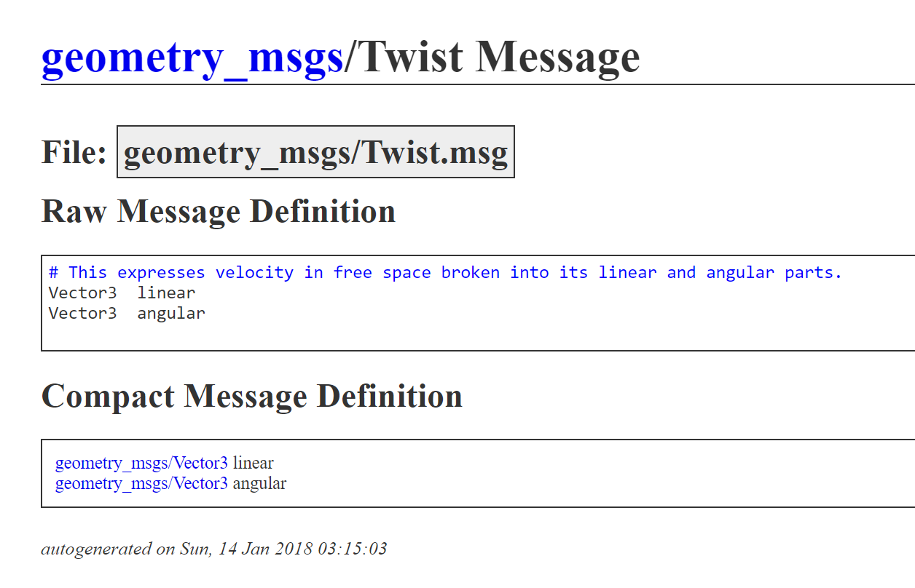
Example ROS Message Definition:
rostopic pub -r 10 /cmd_vel geometry_msgs/Twist '{linear: {x: 0.1, y: 0.0, z: 0.0}, angular: {x: 0.0,y: 0.0,z: 0.0}}'

Slide 37
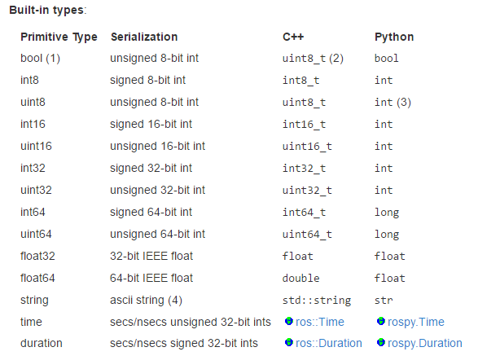
Message Types
You must not use the names of built-in types or header when constructing your own message types.

Slide 38
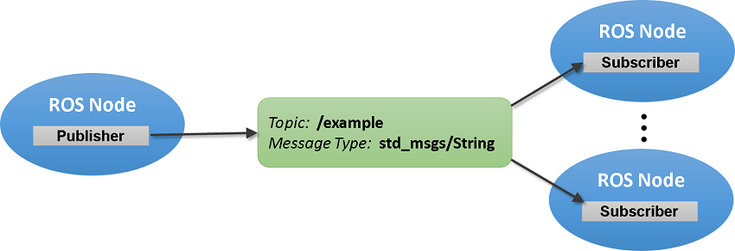
Summary of ROS Messages
Image Source Link

Slide 39
Remapping Example 1
Topic: chatter
Msg: String
Topic: chatter
Msg: String
talker.py
listener.py

Slide 40
Example 1
Student 1 : rosrun rospy_tutorials listener.py
Student 2 : rosrun rospy_tutorials talker.py

Slide 41
Remapping Example 2
Topic: chatter1
Msg: String
Topic: chatter1
Msg: String
Topic: chatter2
Msg: String
Topic: chatter2
Msg: String
talker.py
listener.py
talker.py
listener.py
Student 1
Student 2
Student 3
Student 4
Topic: chatter3
Msg: String
Topic: chatter3
Msg: String
talker.py
listener.py
Student 5
Student 6

Slide 42
Remapping Arguments
Any ROS name within a node can be remapped when it is launched at the command-line.
http://wiki.ros.org/Remapping%20Arguments

Slide 43
ROS Package
Software in ROS is organized in packages.
A package can contain your ROS nodes, any libraries, a dataset, configuration files, message types, scripts, service types, some third-party software.
When you want to create a project in ROS, first you need to create a package
You can also download and install many packages written by other ROS users around the world
You can submit the ROS package you write to the ROS package repository
Every ROS package is for certain ROS distributions
Packages have dependencies
http://www.ros.org/browse/list.php?package_type=package&distro=indigo

Slide 44
ROS Launch
Sometimes you have so many nodes with many different arguments and parameters to run in a project.
Roslaunch is a tool for easily launching multiple ROS nodes as well as setting parameters in the parameter server.
The basic idea is to list, in a specific XML format, a group of nodes that should be started at the same time.

Slide 45
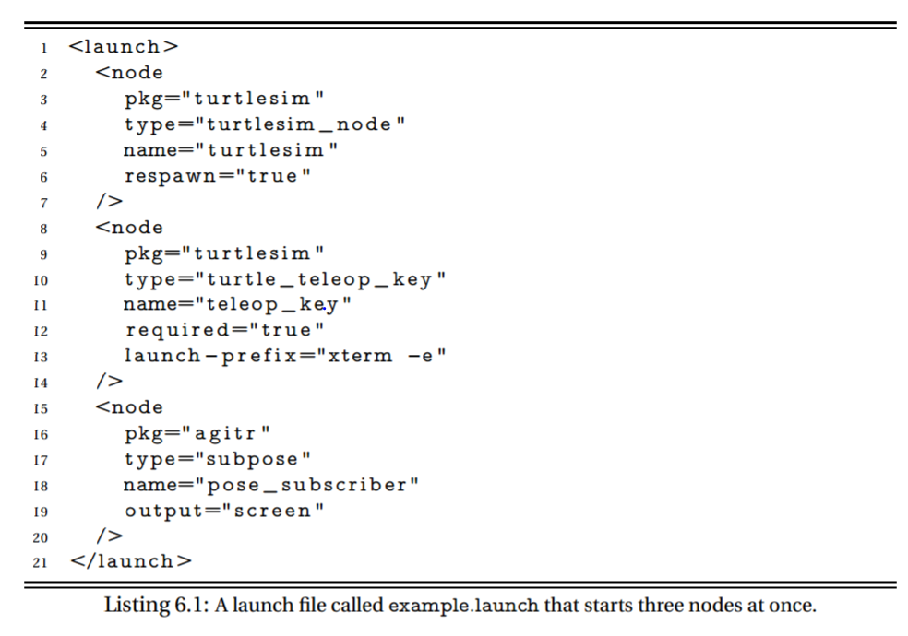
Example Launch File

Slide 46
Some useful ROS command-line tools
rospack: find and retrieve information about packages
catkin_create_pkg: create a new package
catkin_make: build a workspace of packages
rosdep: install system dependencies of a package
rqt: In rqt there is a plugin called "Introspection/Package Graph", which visualizes package dependencies as a graph

Slide 47
XML Format
Xml stands for extensible markup language.
<note> <to>Tove</to> <from>Jani</from> <heading>Reminder</heading> <body>Don't forget me this weekend!</body> </note>
The XML above does not DO anything. XML is just information wrapped in tags.

Slide 48
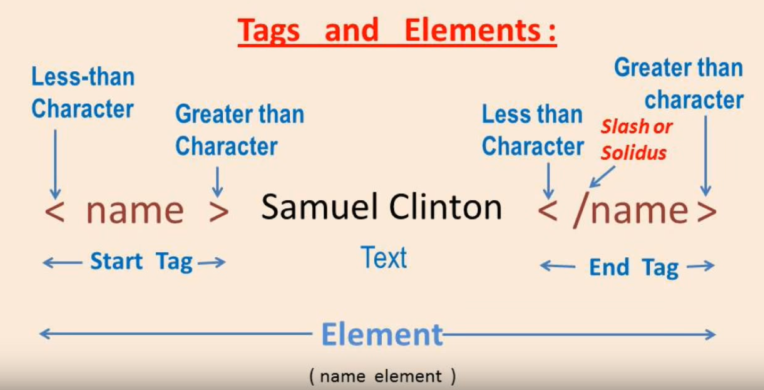
XML Tags and Elements
https://www.youtube.com/watch?v=nyk8QO08grM

Slide 49
Why XML?
It simplifies data sharing
It simplifies data transport
It simplifies platform changes
It simplifies data availability
If you want to learn more about xml:
https://www.w3schools.com/xml/default.asp

Slide 50
ROS File System
Packages: Packages are the software organization unit of ROS code. Each package can contain libraries, executables, scripts, or other artifacts.
Manifests (package.xml): A manifest is a description of a package. It serves to define dependencies between packages and to capture meta information about the package like version, maintainer, license, etc...

Slide 51
rospack
rospack : gives you information about the package
rospack find package_name
ex: rospack find roscpp

Slide 52
roscd
It is used to change directory to a package or a stack.
roscd package_name
You can also use roscd to move into sub directories.
roscd package_name/sub_directory

Slide 53
rosls
It is used to list to directories inside a package.
rosls roscpp_tutorials
Cmake launch package.xml srv

Slide 54
rosdep
It is used to install system dependencies.
rosdep install my_package
rosdep install --from-paths src --ignore-src --rosdistro indigo

Slide 55
How to Install ROS Packages?
There are two ways to do it.
If there is a Debian package it is easy to install.
If there is no deb package, you have to install it from by sources.

Slide 56
Method 1
apt-get install ros-<ros-distribution>-<package-name>
Example:
http://www.ros.org/browse/list.php
apt-get install ros-indigo-effort-controllers

Slide 57
Method 2
- cd catkin_ws/src
- https://github.com/ros/ros_tutorials
- git clone -b indigo-devel https://github.com/ros/ros_tutorials.git
- cd catkin_ws
- rosdep install --from-paths src --ignore-src --rosdistro indigo
- catkin_make

Slide 58
How to Create a ROS Package?
For a package to be considered a catkin package it must meet a few requirements:
The package must contain a catkin compliant package.xml file.
That package.xml file provides meta information about the package.
The package must contain a CMakeLists.txt which uses catkin. If it is a catkin metapackage it must have the relevant boilerplate CMakeLists.txt file.
There can be no more than one package in each folder.
This means no nested packages nor multiple packages sharing the same directory.

Slide 59
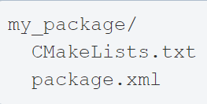
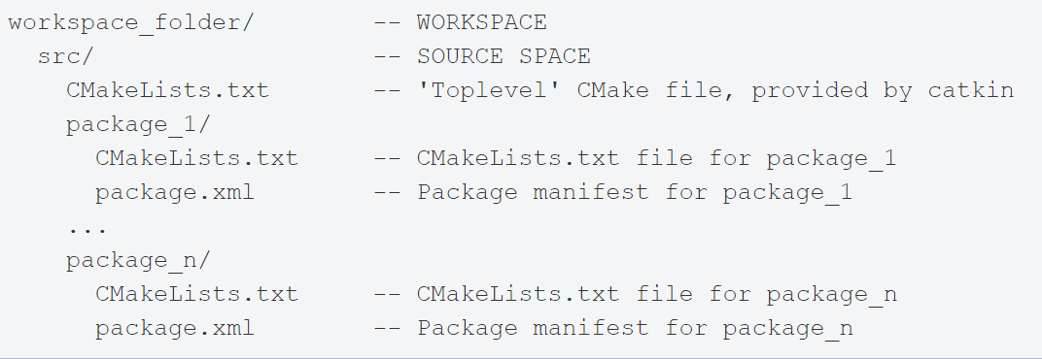
ROS Package
Way 1:
Way 2:

Slide 60
How to Create a ROS Package?
Create your workspace
Go to your source directory
cd ~/catkin_ws/src
Create a new package
catkin_create_pkg <package_name> [depend1] [depend2] [depend3]
Build the workspace and source the setup.bash file
cd ~/catkin_ws
. ~/catkin_ws/devel/setup.bash

Slide 61
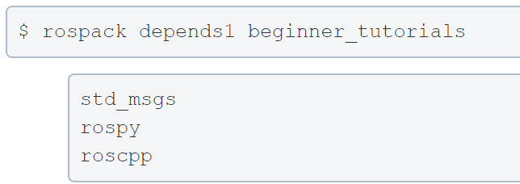
Rospack Dependencies
catkin_create_pkg beginner_tutorials std_msgs rospy roscpp

Slide 62
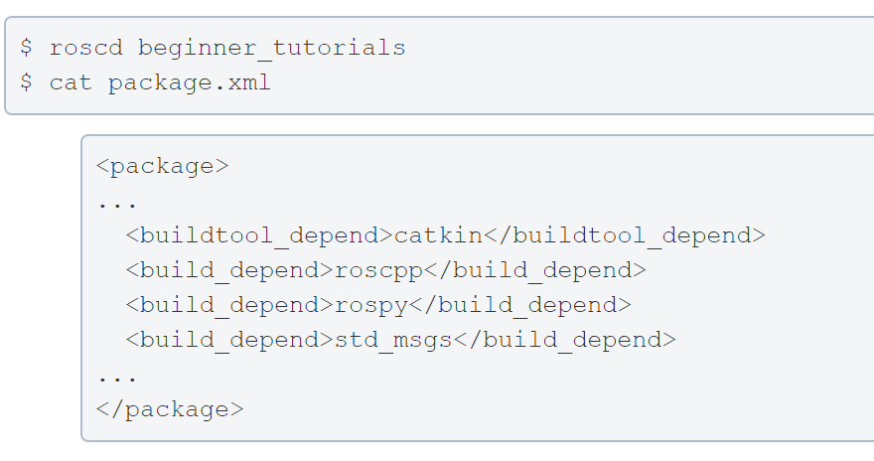
Rospack Dependencies
These dependencies for a package are stored in the package.xml file:

Slide 63
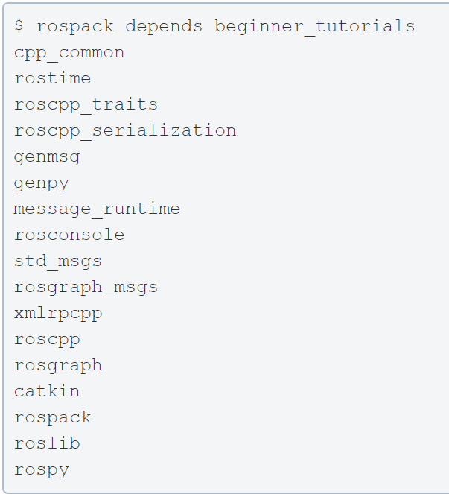
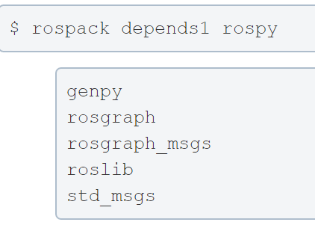
Indrect Dependencies
A dependency can also have its own dependencies.
All indirect dependencies

Slide 64
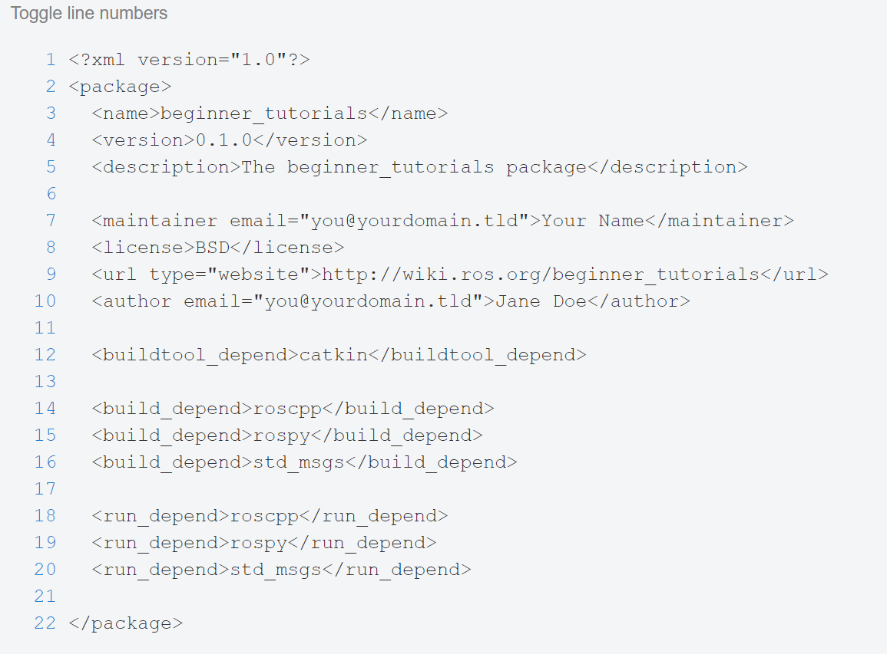
Customize your ROS Package
The generated package.xml should be in your new package.

Slide 65
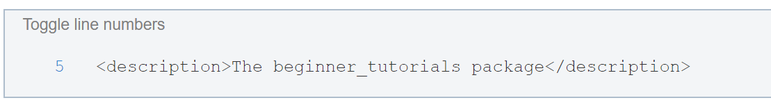
Customize your ROS Package
Description Tag:
Describe your package in a few words

Slide 66
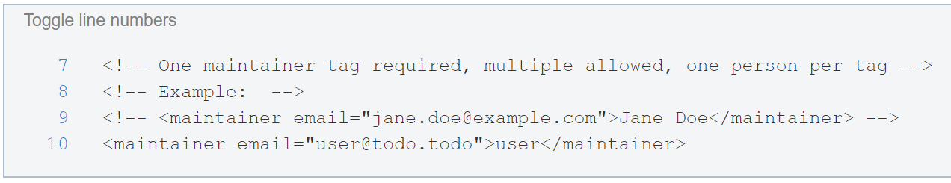
Customize your ROS Package
Maintainer Tags:
This is a required and important tag for the package.xml
Let others know who to contact about the package.

Slide 67
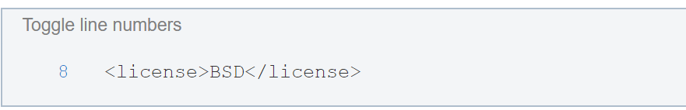
Customize your ROS Package
License Tags:
You should choose a license and fill it in here. Some common open source licenses are BSD, MIT, Boost Software License, GPLv2, GPLv3, LGPLv2.1, and LGPLv3

Slide 68
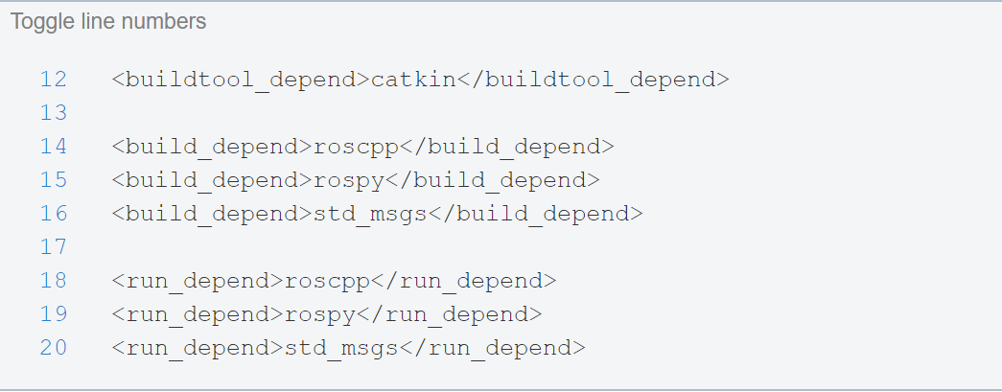
Customize your ROS Package
Dependencies Tags:
We define all of our specified dependencies to be available at build and run time.

Slide 69
ROS Package Review

Slide 70
Rostopic Echo
Rostopic echo is used to show that data published on a certain topic
rostopic echo /turtle1/cmdvel
Let’s do an example

Slide 71
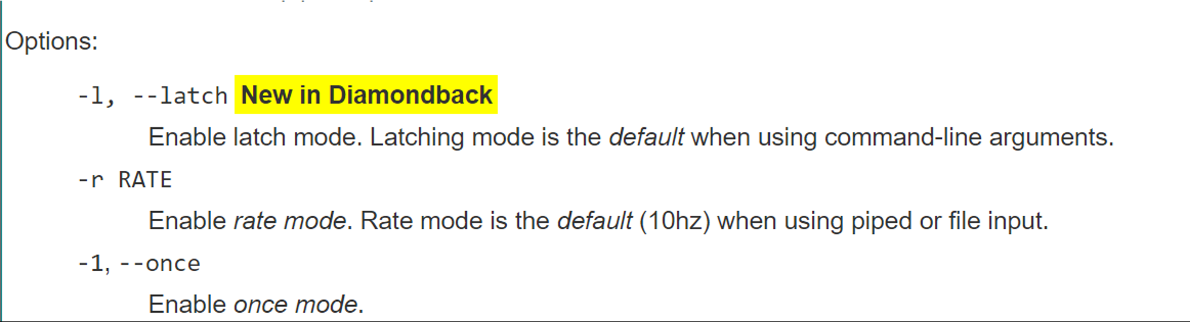
Rostopic Pub
Publishes data to a topic
rostopic pub /topic_name std_msgs/String Perkowski

Slide 72
Subscriber Node
Create a new package
Create a directory called scripts
Create a new file for your python script

Slide 73
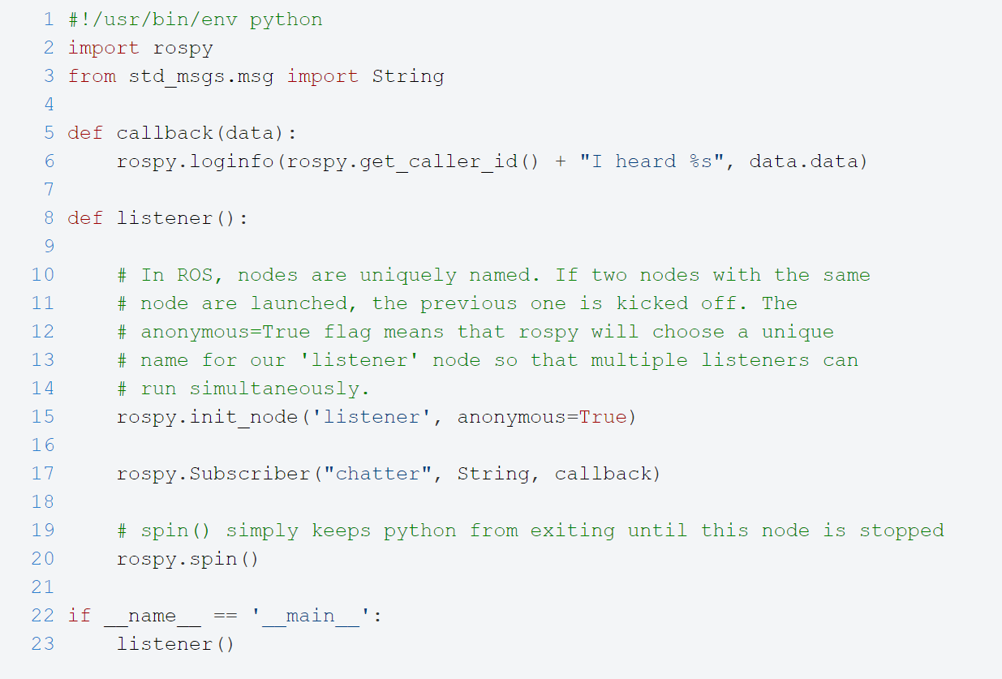

Slide 74
Subscriber Node
Save the file. Name it subscriber1.py
Make the node executable
chmod +x subscriber1.py

Slide 75
Publisher Node
Create a new file for your python script

Slide 76
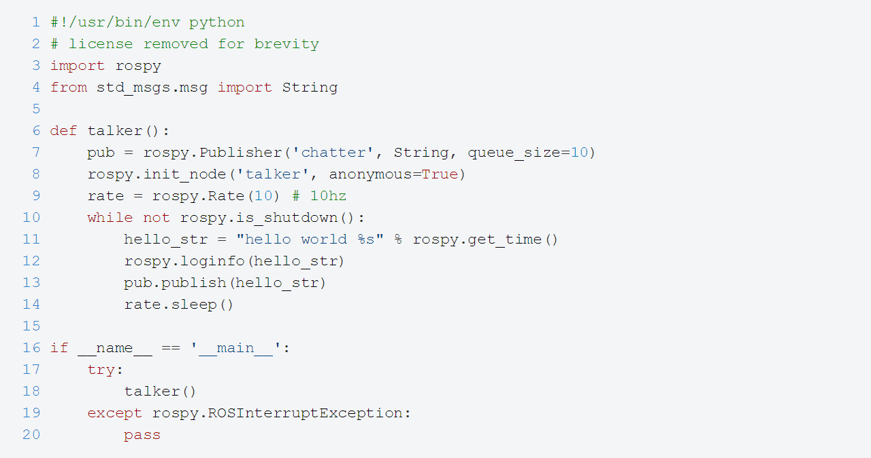
Publisher Node

Slide 77
ROS Launch
roslaunch is a tool for easily launching multiple ROS nodes locally and remotely
It also allows you to set parameters on the Parameter Server.
How to run a launch file:
roslaunch package_name file.launch

Slide 78
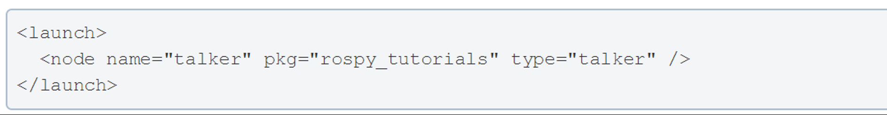
Simple ROS Launch File

Slide 79
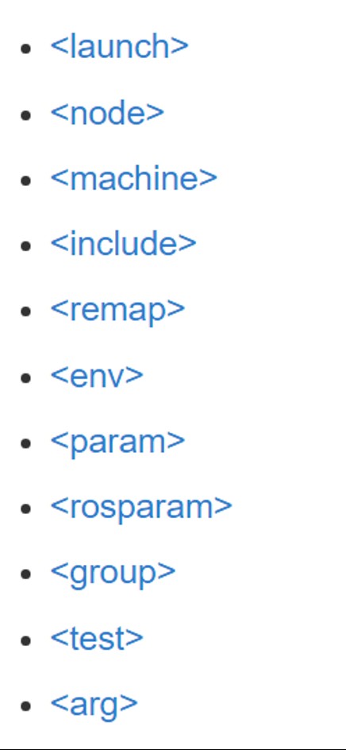
Launch file xml tag references

Slide 80
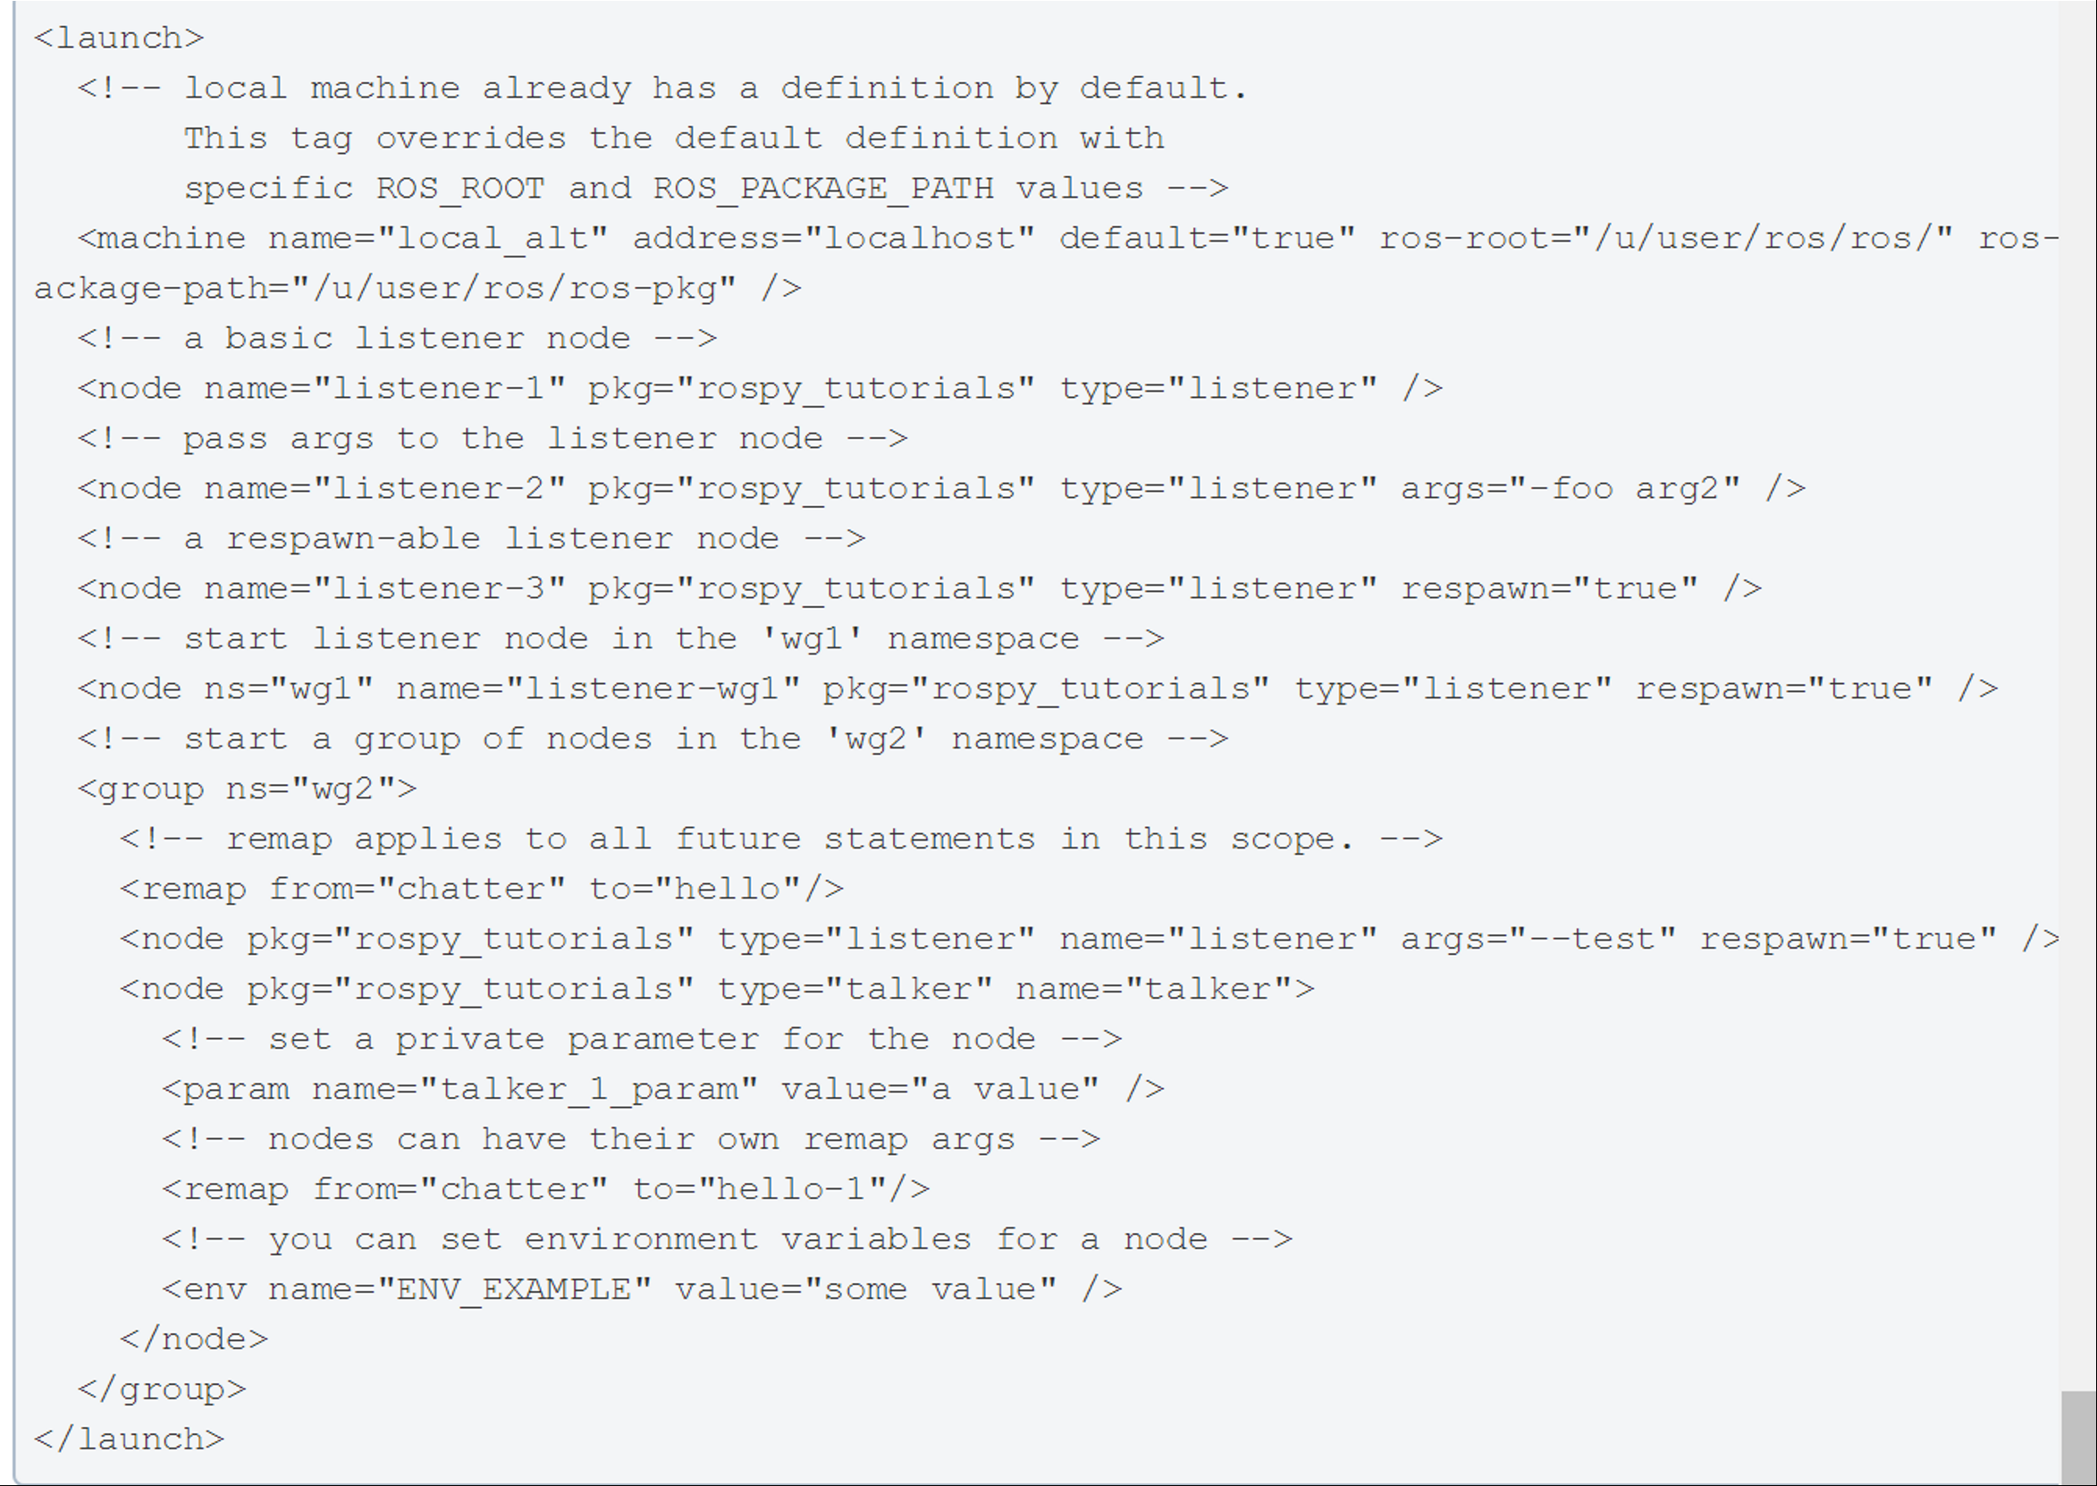
A little bit more complicated one
- respawn="true"(optional) :Restart the node automatically if it quits.
- respawn_delay="30" (optional, default 0) New in ROS indigo : If respawn is true, wait respawn_delay seconds after the node failure is detected before attempting restart.

